Slide 1
Chapter 1 Introduction to Computers, the Internet and Java
Java How to Program, 11/e
Questions? E-mail paul.deitel@deitel.com

Slide 2
Objectives
In this chapter, you will
Get to know the applications of Java
Learn the concept of object-oriented programming—today’s key programming methodology.
Learn a typical Java program-development environment and the different phases

Slide 3
1.1 Introduction (Cont.)
Java is also widely used for implementing Internet-based applications and software for devices that communicate over a network.
According to Oracle’s 2016 JavaOne conference keynote presentation (http://bit.ly/JavaOne2016Keynote), there are now 10 million Java developers worldwide and Java runs on 15 billion devices (Fig. 1.1), including two billion vehicles and 350 million medical devices.
In addition, the explosive growth of mobile phones, tablets and other devices is creating significant opportunities for programming mobile apps.

Slide 4
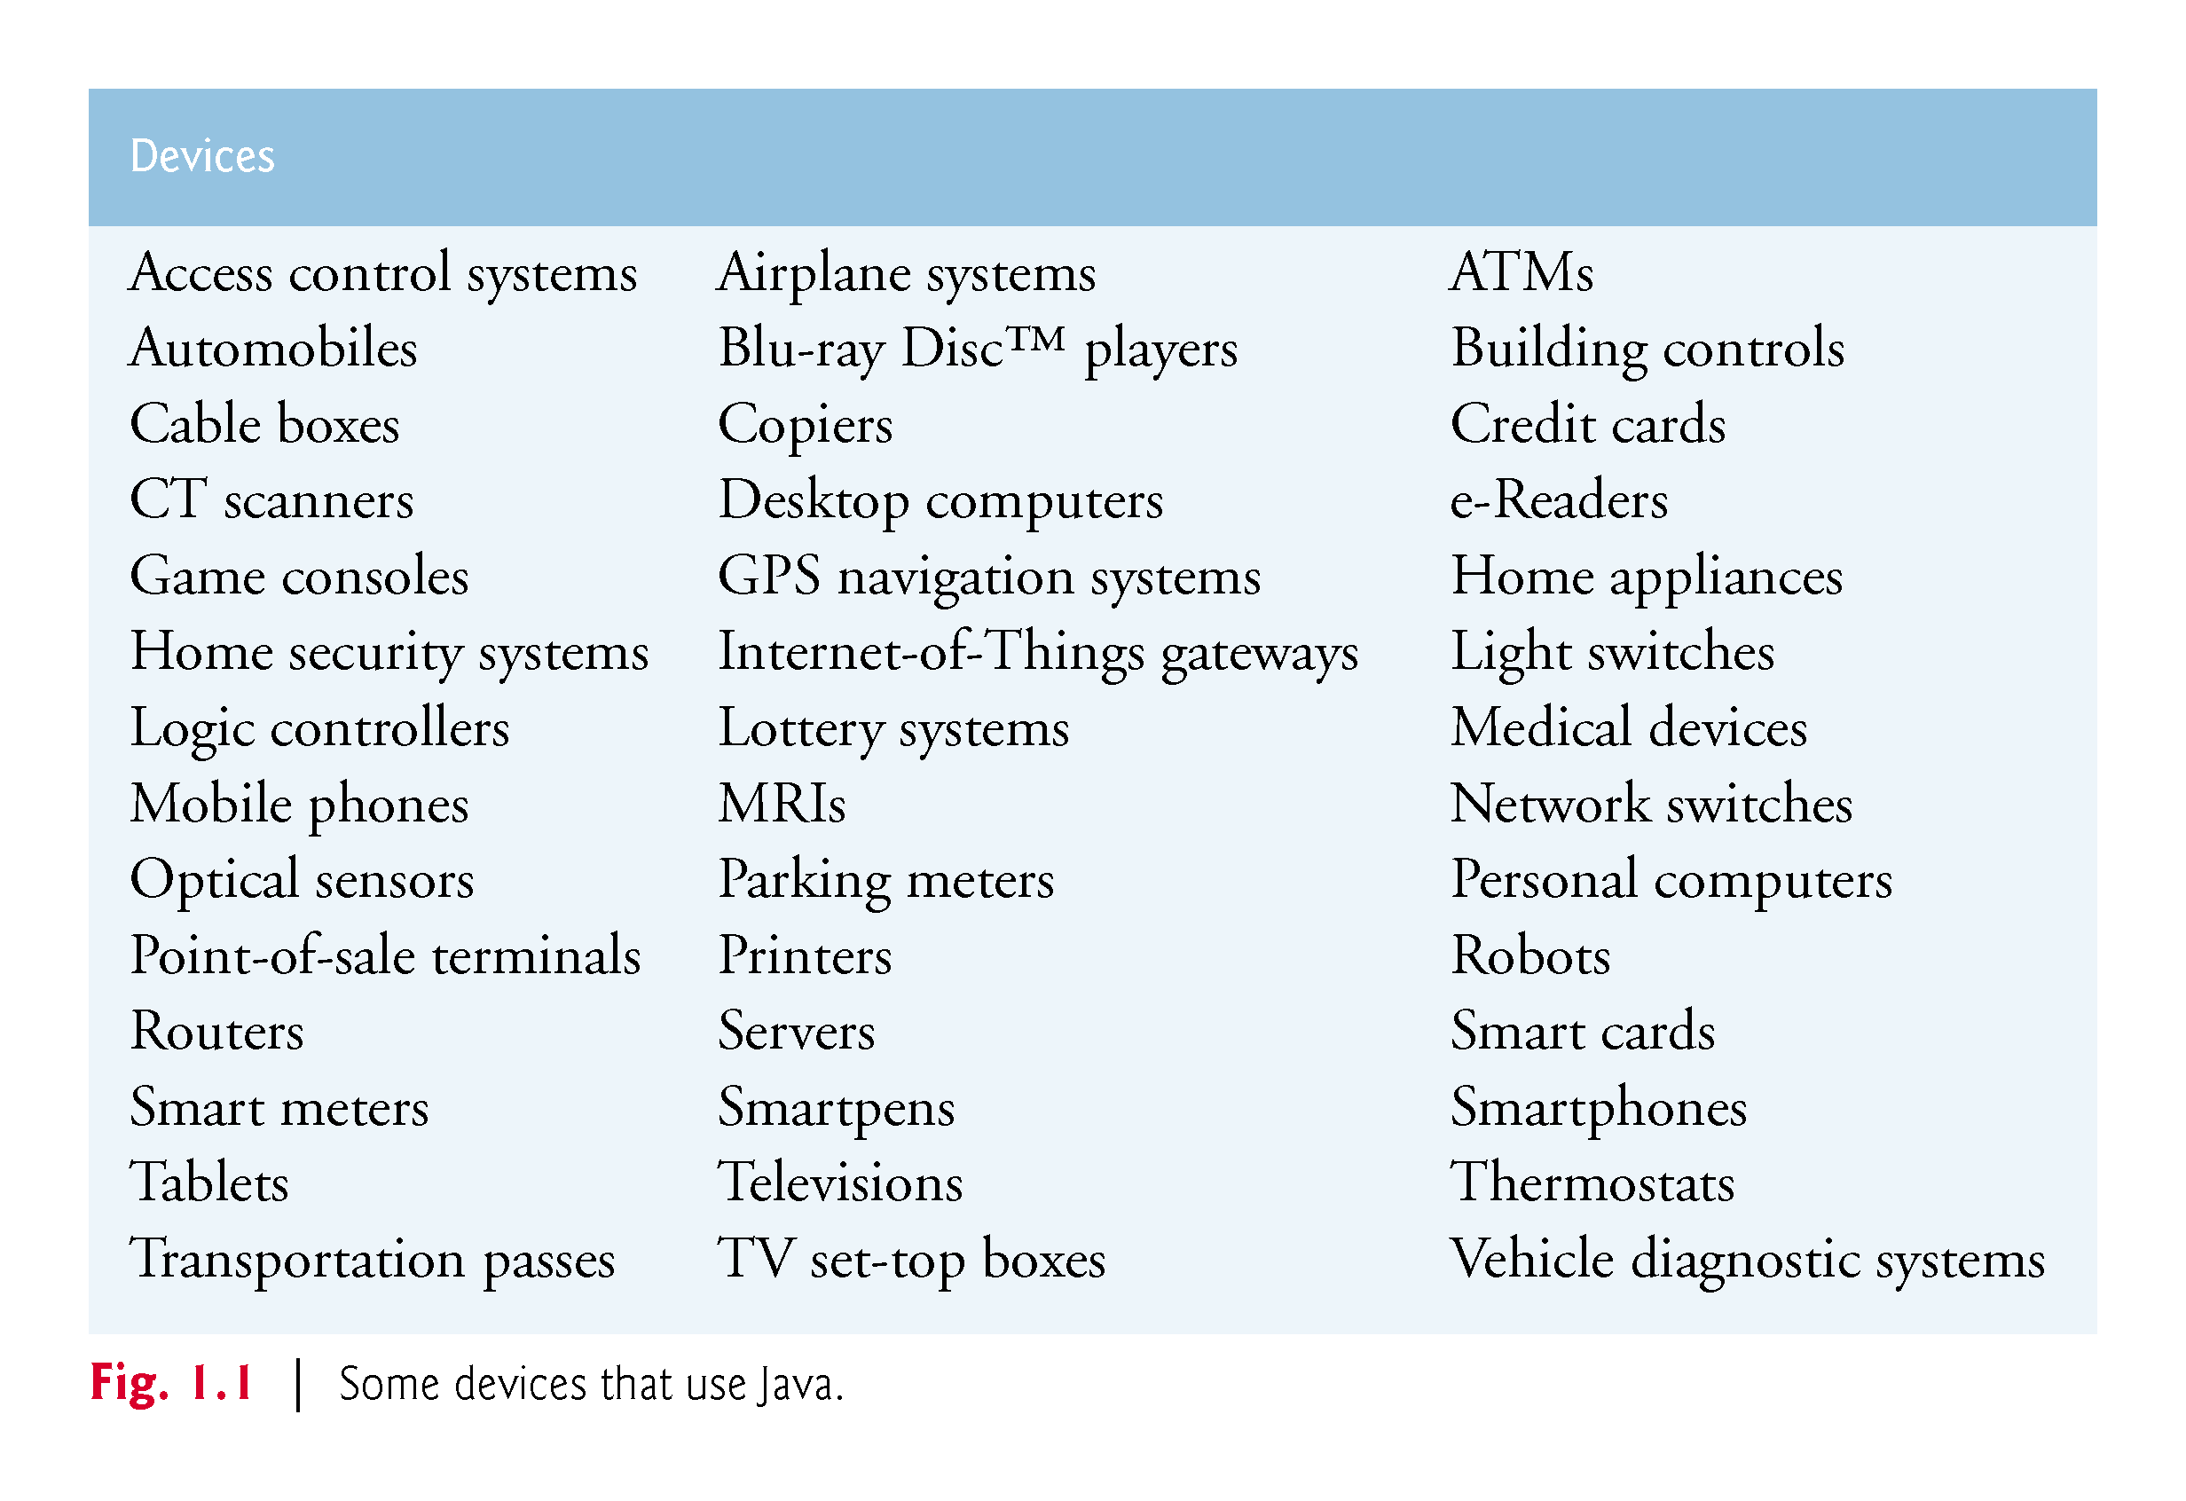

Slide 5
1.1 Introduction (Cont.)
Java Standard Edition
Java Standard Edition contains the capabilities needed to develop desktop and server applications.
Prior to Java SE 8, Java supported three programming paradigms
Procedural programming
Object-oriented programming
Generic programming
Java SE 8 added the beginnings of functional programming with lambdas and streams

Slide 6
1.1 Introduction (Cont.)
Java Enterprise Edition
Java is used in such a broad spectrum of applications that it has two other editions.
The Java Enterprise Edition (Java EE) is geared toward developing large-scale, distributed networking applications and web-based applications.

Slide 7
1.1 Introduction (Cont.)
Java Micro Edition (Java ME)
Subset of Java SE.
Geared toward developing applications for resource-constrained embedded devices, such as
Smartwatches
MP3 players
television set-top boxes
smart meters (for monitoring electric energy usage)
and more.
Many of the devices in use Java ME.

Slide 8
1.5 Introduction to Object Technology
Objects, or more precisely, the classes objects come from, are essentially reusable software components.
There are date objects, time objects, audio objects, video objects, automobile objects, people objects, etc.
Almost any noun can be reasonably represented as a software object in terms of attributes (e.g., name, color and size) and behaviors (e.g., calculating, moving and communicating).
Software development groups can use a modular, object-oriented design-and-implementation approach to be much more productive than with earlier popular techniques like “structured programming”—object-oriented programs are often easier to understand, correct and modify.

Slide 9
1.5.1 The Automobile as an Object
Automobile as an Object
Suppose you want to drive a car and make it go faster by pressing its accelerator pedal.
Before you can drive a car, someone has to design it.
A car typically begins as engineering drawings, similar to the blueprints that describe the design of a house.
Drawings include the design for an accelerator pedal.
Pedal hides from the driver the complex mechanisms that actually make the car go faster, just as the brake pedal hides the mechanisms that slow the car, and the steering wheel “hides” the mechanisms that turn the car.

Slide 10
1.5.1 The Automobile as an Object (Cont.)
Enables people with little or no knowledge of how engines, braking and steering mechanisms work to drive a car easily.
Before you can drive a car, it must be built from the engineering drawings that describe it.
A completed car has an actual accelerator pedal to make it go faster, but even that’s not enough—the car won’t accelerate on its own (hopefully!), so the driver must press the pedal to accelerate the car.

Slide 11
1.5.2 Methods and Classes
Performing a task in a program requires a method.
The method houses the program statements that actually perform its tasks.
Hides these statements from its user, just as the accelerator pedal of a car hides from the driver the mechanisms of making the car go faster.
In Java, we create a program unit called a class to house the set of methods that perform the class’s tasks.
A class is similar in concept to a car’s engineering drawings, which house the design of an accelerator pedal, steering wheel, and so on.

Slide 12
1.5.3 Instantiation
Just as someone has to build a car from its engineering drawings before you can actually drive a car, you must build an object of a class before a program can perform the tasks that the class’s methods define.
An object is then referred to as an instance of its class.

Slide 13
1.5.4 Reuse
Just as a car’s engineering drawings can be reused many times to build many cars, you can reuse a class many times to build many objects.
Reuse of existing classes when building new classes and programs saves time and effort.
Reuse also helps you build more reliable and effective systems, because existing classes and components often have undergone extensive testing, debugging and performance tuning.
Just as the notion of interchangeable parts was crucial to the Industrial Revolution, reusable classes are crucial to the software revolution that has been spurred by object technology.

Slide 14
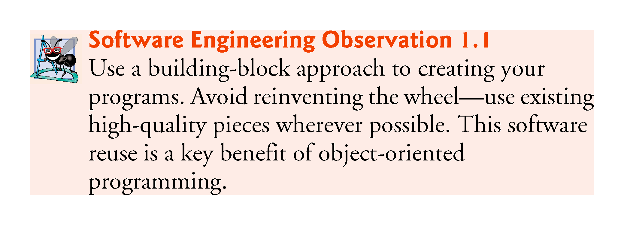

Slide 15
1.5.5 Messages and Method Calls
When you drive a car, pressing its gas pedal sends a message to the car to perform a task—that is, to go faster.
Similarly, you send messages to an object.
Each message is implemented as a method call that tells a method of the object to perform its task.

Slide 16
1.5.6 Attributes and Instance Variables
A car has attributes
Color, its number of doors, the amount of gas in its tank, its current speed and its record of total miles driven (i.e., its odometer reading).
The car’s attributes are represented as part of its design in its engineering diagrams.
Every car maintains its own attributes.
Each car knows how much gas is in its own gas tank, but not how much is in the tanks of other cars.

Slide 17
1.5.6 Attributes and Instance Variables (Cont.)
An object, has attributes that it carries along as it’s used in a program.
Specified as part of the object’s class.
A bank-account object has a balance attribute that represents the amount of money in the account.
Each bank-account object knows the balance in the account it represents, but not the balances of the other accounts in the bank.
Attributes are specified by the class’s instance variables.

Slide 18
1.5.7 Encapsulation and Information Hiding
Classes (and their objects) encapsulate, i.e., encase, their attributes and methods.
Objects may communicate with one another, but they’re normally not allowed to know how other objects are implemented—implementation details can be hidden within the objects themselves.
Information hiding, as we’ll see, is crucial to good software engineering.

Slide 19
1.5.8 Inheritance
A new class of objects can be created conveniently by inheritance—the new class (called the subclass) starts with the characteristics of an existing class (called the superclass), possibly customizing them and adding unique characteristics of its own.
In our car analogy, an object of class “convertible” certainly is an object of the more general class “automobile,” but more specifically, the roof can be raised or lowered.

Slide 20
1.5.9 Interfaces
Interfaces are collections of related methods that typically enable you to tell objects what to do, but not how to do it (we’ll see exceptions to this in Java SE 8 and 9 when we discuss interfaces in Chapter 10).
In the car analogy, a “basic-driving-capabilities” interface consisting of a steering wheel, an accelerator pedal and a brake pedal would enable a driver to tell the car what to do.
Once you know how to use this interface for turning, accelerating and braking, you can drive many types of cars, even though manufacturers may implement these systems differently.

Slide 21
1.5.9 Interfaces (Cont.)
A class implements zero or more interfaces, each of which can have one or more methods, just as a car implements separate interfaces for basic driving functions, controlling the radio, controlling the heating and air conditioning systems, and the like.
Just as car manufacturers implement capabilities differently, classes may implement an interface’s methods differently.

Slide 22
1.5.10 Object-Oriented Analysis and Design (OOAD)
How will you create the code (i.e., the program instructions) for your programs?
Follow a detailed analysis process for determining your project’s requirements (i.e., defining what the system is supposed to do)
Develop a design that satisfies them (i.e., specifying how the system should do it).
Carefully review the design (and have your design reviewed by other software professionals) before writing any code.

Slide 23
1.5.10 Object-Oriented Analysis and Design (OOAD) (Cont.)
Analyzing and designing your system from an object-oriented point of view is called an object-oriented-analysis-and-design (OOAD) process.
Languages like Java are object oriented.
Object-oriented programming (OOP) allows you to implement an object-oriented design as a working system.

Slide 24
1.5.11 The UML (Unified Modeling Language)
The Unified Modeling Language (UML) is the most widely used graphical scheme for modeling object-oriented systems.

Slide 25
1.8 Java (Cont.)
Java Class Libraries
Rich collections of existing classes and methods
Also known as the Java APIs (Application Programming Interfaces).

Slide 26
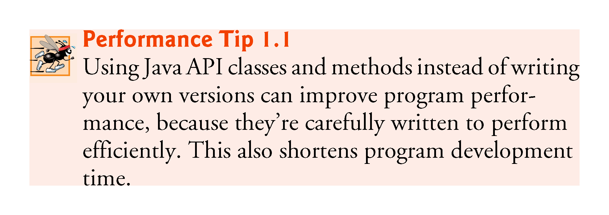

Slide 27
1.9 A Typical Java Development Environment
Normally there are five phases
edit
compile
load
verify
execute.
See the Before You Begin section for information on downloading and installing the JDK on Windows, Linux and macOS.

Slide 28
1.9 A Typical Java Development Environment (Cont.)
Phase 1 consists of editing a file with an editor program
Using the editor, you type a Java program (source code).
Make any necessary corrections.
Save the program.
Java source code files are given a name ending with the .java extension indicating that the file contains Java source code.

Slide 29
1.9 A Typical Java Development Environment (Cont.)
Two editors widely used on Linux systems are vi and emacs
Windows provides Notepad.
macOS provides TextEdit.
Many freeware and shareware editors are also available online, including
Notepad++ (http://notepad-plus-plus.org)
EditPlus (http://www.editplus.com)
TextPad (http://www.textpad.com)
jEdit (http://www.jedit.org) and more.

Slide 30
1.9 A Typical Java Development Environment (Cont.)
Integrated development environments (IDEs) provide tools that support the software development process, such as editors, debuggers for locating logic errors that cause programs to execute incorrectly and more.
The most popular Java IDEs are:
Eclipse (http://www.eclipse.org)
IntelliJ IDEA (http://www.jetbrains.com)
NetBeans (http://www.netbeans.org)

Slide 31
1.9 A Typical Java Development Environment (Cont.)
Phase 2: Compiling a Java Program into Bytecodes
Use the command javac (the Java compiler) to compile a program. For example, to compile a program called Welcome.java, you’d type
javac Welcome.java
If the program compiles, the compiler produces a .class file called Welcome.class that contains the compiled version.

Slide 32
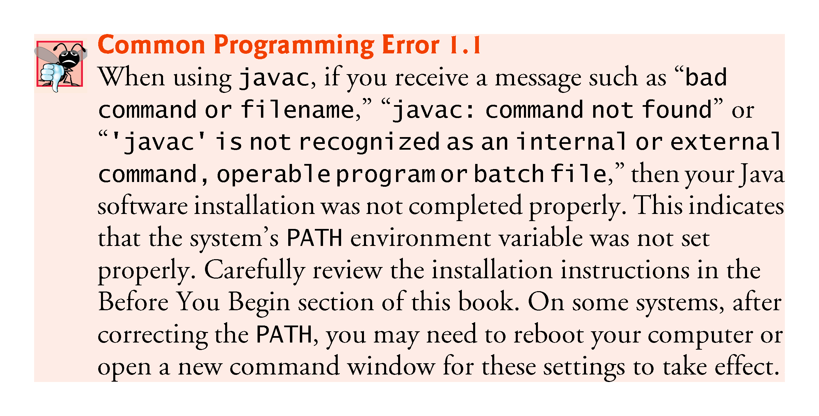

Slide 33
1.9 A Typical Java Development Environment (Cont.)
Java compiler translates Java source code into bytecodes that represent the tasks to execute.
The Java Virtual Machine (JVM)—a part of the JDK and the foundation of the Java platform—executes bytecodes.
Virtual machine (VM)—a software application that simulates a computer
Hides the underlying operating system and hardware from the programs that interact with it.
If the same VM is implemented on many computer platforms, applications written for that type of VM can be used on all those platforms.

Slide 34
1.9 A Typical Java Development Environment (Cont.)
Bytecode instructions are platform independent
Bytecodes are portable
The same bytecode instructions can execute on any platform containing a JVM that understands the version of Java in which the bytecode instructions were compiled.
The JVM is invoked by the java command. For example, to execute a Java application called Welcome, you’d type the command
java Welcome

Slide 35
1.9 A Typical Java Development Environment (Cont.)
Phase 3: Loading a Program into Memory
The JVM places the program in memory to execute it—this is known as loading.
Class loader takes the .class files containing the program’s bytecodes and transfers them to primary memory.
Also loads any of the .class files provided by Java that your program uses.
The .class files can be loaded from a disk on your system or over a network.

Slide 36
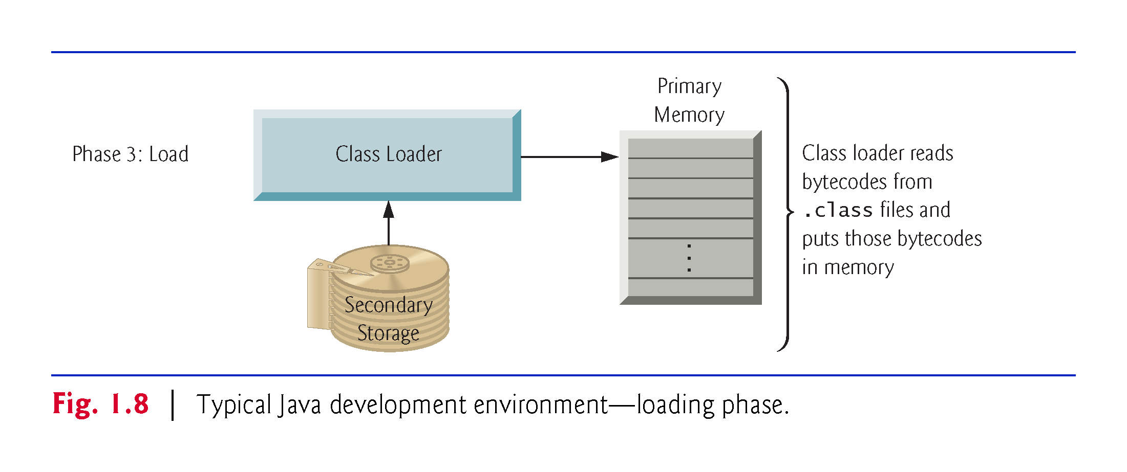

Slide 37
1.9 A Typical Java Development Environment (Cont.)
Phase 4: Bytecode Verification
As the classes are loaded, the bytecode verifier examines their bytecodes
Ensures that they’re valid and do not violate Java’s security restrictions.
Java enforces strong security to make sure that Java programs arriving over the network do not damage your files or your system (as computer viruses and worms might).

Slide 38
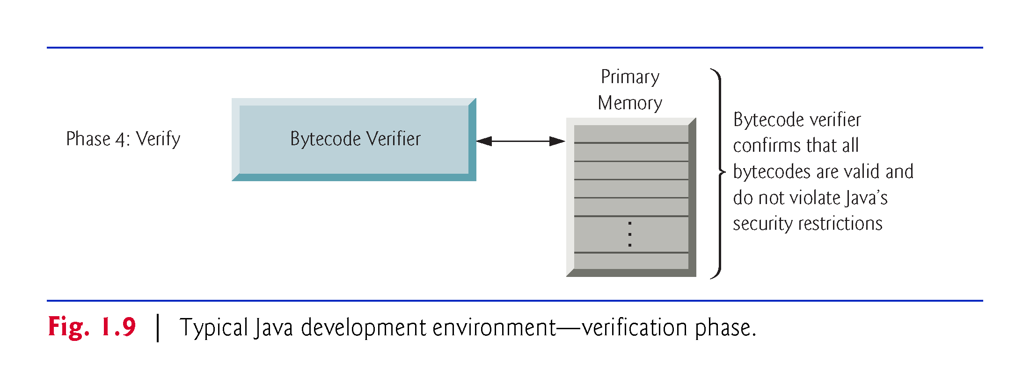

Slide 39
1.9 A Typical Java Development Environment (Cont.)
Phase 5: Execution
The JVM executes the program’s bytecodes.
JVMs typically execute bytecodes using a combination of interpretation and so-called just-in-time (JIT) compilation.
Analyzes the bytecodes as they’re interpreted
A just-in-time (JIT) compiler—such as Oracle’s Java HotSpot™ compiler—translates the bytecodes into the underlying computer’s machine language.

Slide 40
1.9 A Typical Java Development Environment (Cont.)
When the JVM encounters these compiled parts again, the faster machine-language code executes.
Java programs go through two compilation phases
One in which source code is translated into bytecodes (for portability across JVMs on different computer platforms) and
A second in which, during execution, the bytecodes are translated into machine language for the actual computer on which the program executes.

Slide 41
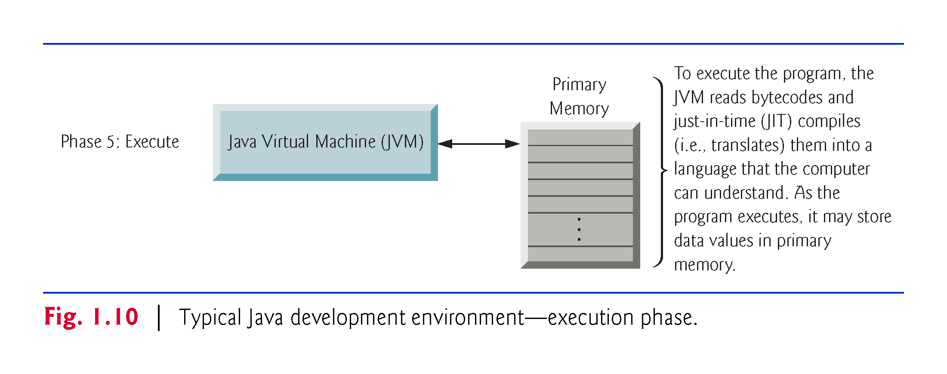

Slide 42
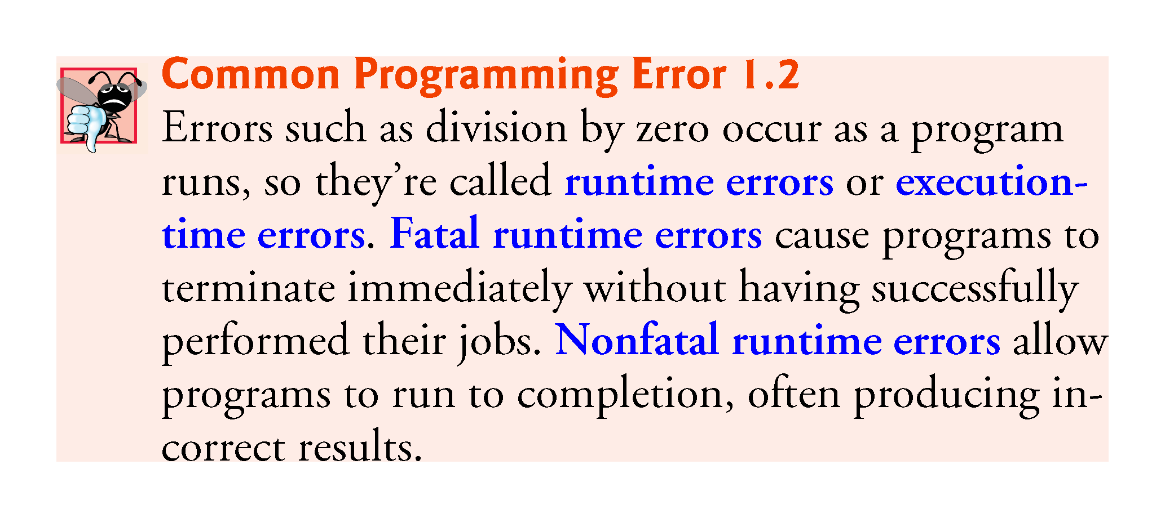

Slide 43
1.14 Getting Your Questions Answered
There are many online forums in which you can get your Java questions answered and interact with other Java programmers.
Some popular Java and general programming forums include:
StackOverflow.com
Coderanch.com
The Oracle Java Forum—https://community.oracle.com/community/java
</dream.in.code>—http://www.dreamincode.net/forums/forum/32-java/

